Slide 1

Wine Quality Prediction
By: Ryan Kracaw, Salem Okullo, Hui Wang, Opeyemi Sodipe

Slide 2
Table of Content
Introduction
Overview/Objective
Data Preparation and Methodology
Model Development
Analysis and Visualization
Application/Summary

Slide 3
Overview/Objective
The goal for this analysis is to be able to predict the quality of wine based on certain attributes.
The datasets to be considered contains chemical descriptions of red and white wines, wine quality is modelled to analyze the quality through different parameters.
Output obtained would be checked for correctness and model will be optimized accordingly.
Data Source: data.world
The two datasets are related to red and white variants of the Portuguese "Vinho Verde" wine. Vinho Verde refers to Portuguese wine that originated in the historic Minho province in the far north of the country.
The datasets had features like fixed acidity, volatile acidity, citric acid, residual sugar, chlorides, free sulphur dioxide, density total sulphur dioxide, pH, sulphates and alcohol.

Slide 4
Data Preparation / Methodology
Data Understanding and Cleaning
This report outlines the methodology employed to prepare two distinct datasets (white_wine and red_wine) for subsequent analysis. The datasets contain multiple physicochemical properties and quality ratings of white and red wines respectively. The primary objective was to validate, clean and amalgamate these datasets into a single table, within a MySQL database environment.
The data preparation phase was executed successfully, encompassing critical steps such as data validation, cleaning, and unification. This unified dataset is now primed for the next stages and expected to serve as the basis for further machine learning and visualization analysis
Exploratory Analysis
Visualizations were created to explore the target variable and examine the potential existence of outliers or corrupt data. Further visualized the relationship between the target and the feature variables and relationships between features.

Slide 5
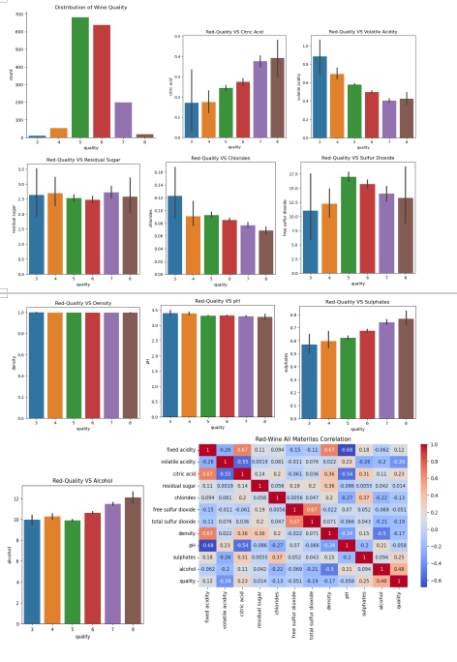
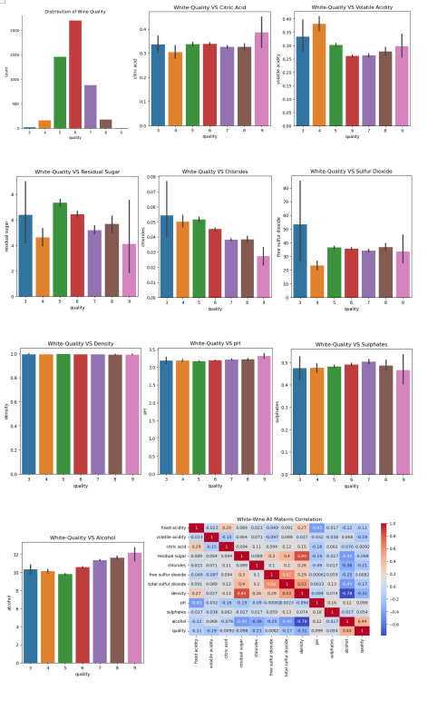
What materials cause the quality of Red and White Wine
A. Quality Visualization of Red Wine
B. Quality Visualization of White Wine
saasdasdfssaf

Slide 6
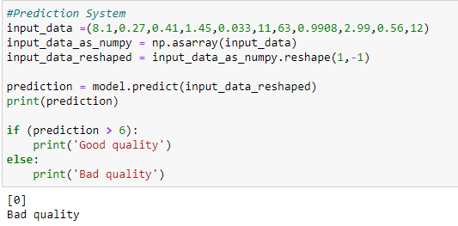
How to use prediction system to predict quality

Slide 7
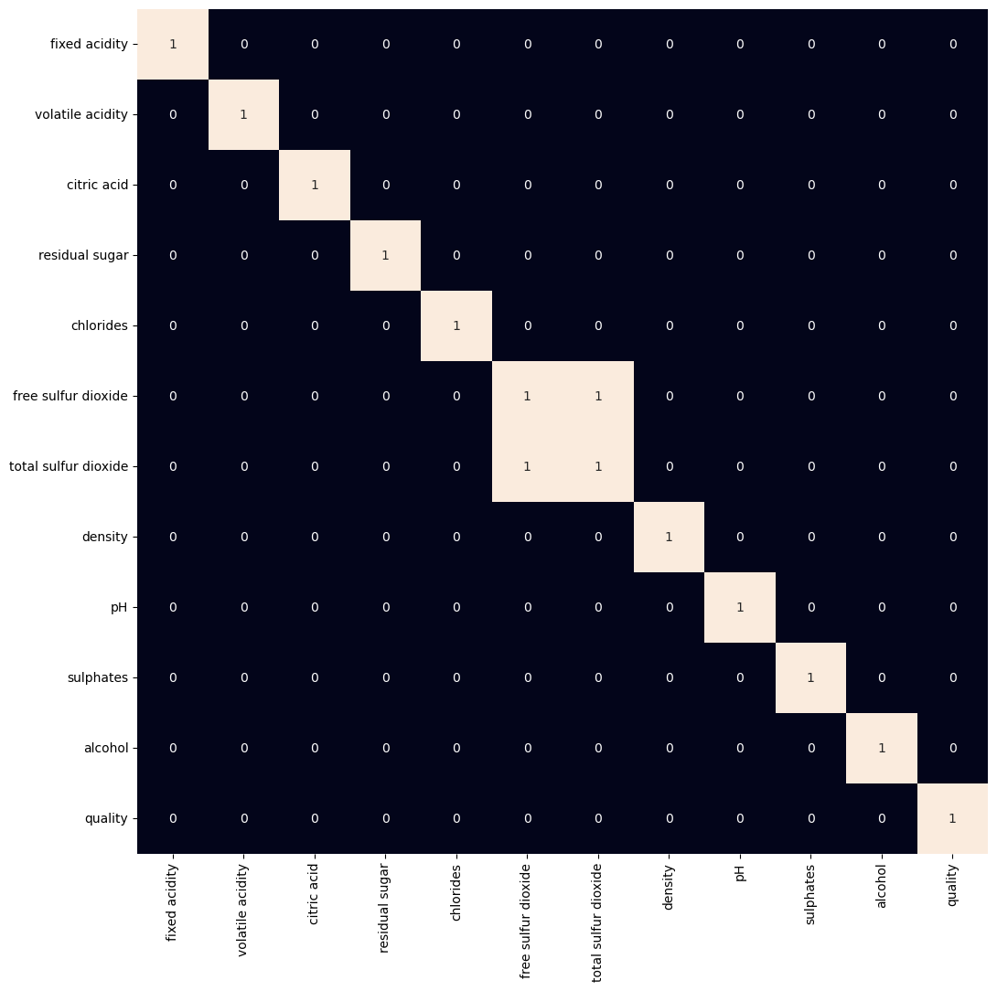
Machine Learning Model 1 - Logistic Regression
Heat map to show columns that are highly correlated
Drop highly correlated columns
‘Total Sulfur Dioxide’
Reason: Variables that are highly correlated carry almost the same information, making it redundant to include all of them in a model.

Slide 8
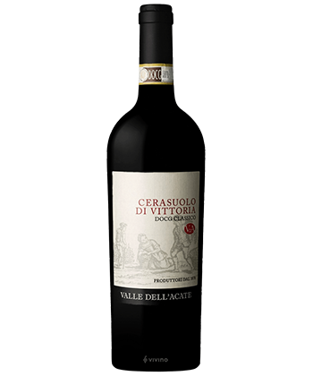
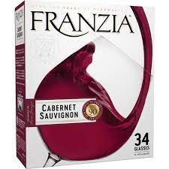
Error Types in the Context of our Project
False Positive: (Type 1 Error)
The model predicted a bottle of wine was of high quality but it was of low quality.
False Negative: (Type 2 Error)
The model predicted a bottle of wine was of low quality but it was of high quality.
Excellent!
Horrible!
False Negative
False Positive

Slide 9
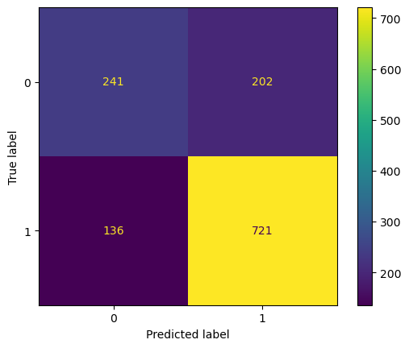
Machine Learning Model 1 - Logistic Regression
Accuracy Score: 74%
True Positive: 721
False Positive: 202
False Negative: 136
True Negative: 241
Recall: 0.84
Precision: 0.78
F1 Score: 0.81
We had more false positives meaning the model predicted a wine was of high quality but actually wasn’t. This brings out precision down.

Slide 10

Machine Learning Model 2- Support Vector Machine (SVC) Model
Accuracy Score: 75%
True Positive: 730
False Positive: 199
False Negative: 127
True Negative: 244
Recall: 0.85
Precision: 0.78
F1 Score: 0.81
Very similar to the logistic regression.

Slide 11
Machine Learning Model 3 - Extreme Gradient Boosting (XGBoost)
Accuracy Score: 82%
True Positive: 730
False Positive: 199
False Negative: 127
True Negative: 244
Recall: 0.87
Precision: 0.85
F1 Score: 0.86
This was the most accurate model that I ran. Our true positive increased and our false positive decreased this overall increases our precision.

Slide 12
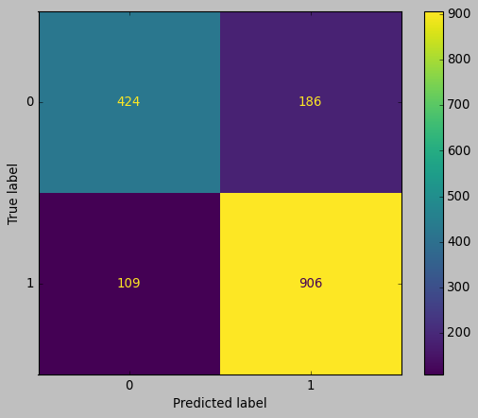
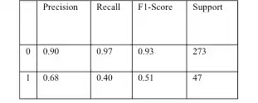
Machine Learning Model 4: Random Forest (RF)
For classification tasks, the class selected by the most trees is the output of random forest.
Accuracy Score: 87%
TP: 906
FP: 186
FN: 109
TN: 424
Precision: .79
Recall: .69
F1 Score : .72
For my classification test, I was able to achieve maximum accuracy using RF.

Slide 13
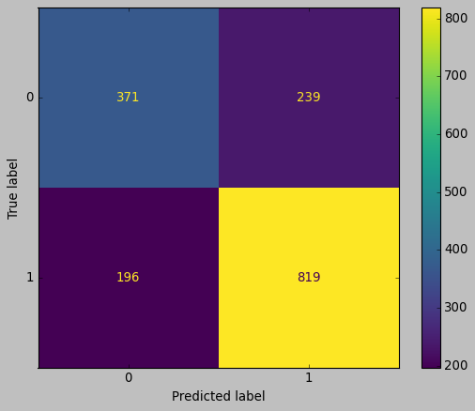
Machine Learning Model 5: Decision Tree (DT)
DT: Supervised learning algorithm, in this case used for classification tasks.
Accuracy score of 84%
Recall: .86
Precision: .82
F1 score: .89
DT was able to give a decent score when everything is averaged up.
TP: 819
FP: 239
TN: 371
FN: 196
Different to RF because Recall, Precision, and F1 Score are higher

Slide 14
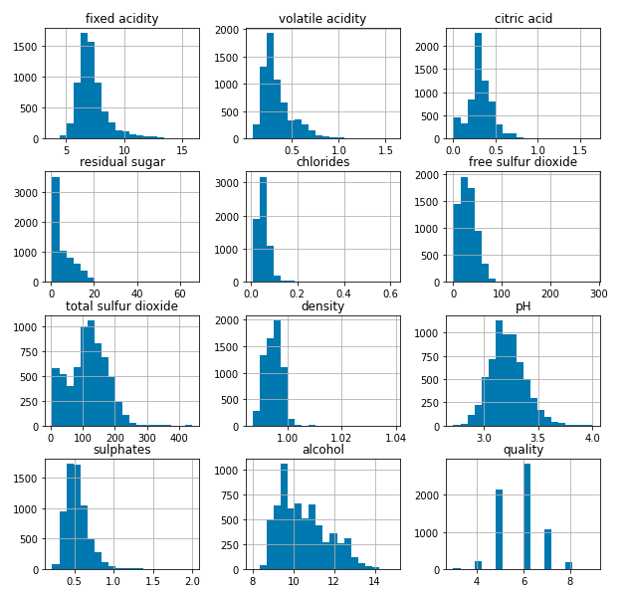
Histogram Charts
No outliers seem to appear from the feature columns except for quality.

Slide 15
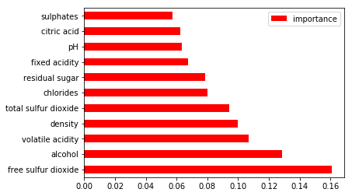
Feature Importance
The graph shows more intuitively free sulfur dioxide and alcohol tend to weigh more in predicting wine quality

Slide 16
Application and Summary
This result can be used by wine manufacturers to improve the quality of future wine.
Result can be used as a guide for wine selection
Certification agencies can use result for quality control

Slide 17

Cheers

